Slide 1
Module 3: List Views
SER 423

Slide 2
Displaying Items in a List

Slide 3
Introducing Lists
Being able to display items in a list has an obvious advantage when it comes to organizing a View
The obvious benefit is being able to present several items in a clean manner
However, you can also add more items to a list than can actually be displayed at once
You can define a size for this list (which itself can only be as big as the screen on the device)
If there are more rows in your list than can be displayed, the User can scroll the list to view the other items
The number of items can change which type of list you choose
ScrollView renders all items at once, even those not displayed
FlatList uses a lazy loading technique to only render items being displayed
There are many types of lists, but we’ll focus on just regular ListView which is a middle ground

Slide 4
Quick Introduction to JSON
JSON is something you may have heard of before, and might have worked with
JavaScript Object Notation
This format is actually how a lot of data gets passed around on the web
We’ll use JSON at multiple points throughout the course, and here we’ll make one of our first uses of it in order to store data to pull from for our list
JSON is essentially formatted like a big map
You define some number of objects, each of which is a string key for a value
These values are usually either numbers, or strings
The idea is that they can be easily converted to an appropriate type

Slide 5
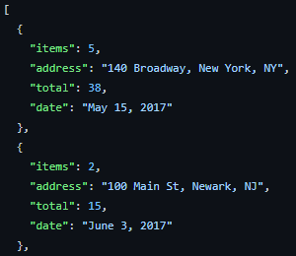
JSON Example

Slide 6
Explaining ListView
For ListView to work we need a few things set first
First, we need what we’re going to display in the rows
  Done in the previous JSON in this case
We need to create a data source object
That object needs a rowHasChanged property, which is a function for comparing the rows
We can call cloneWithRows on this object to fill the list
We can then write a renderRow method to render the JSX code for items in the list
Finally, we write our render method which contains a ListView
This ListView takes a dataSource and a renderRow function

Slide 7
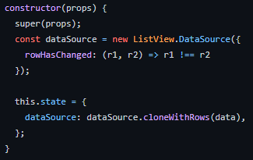
Setting Up the List

Slide 8
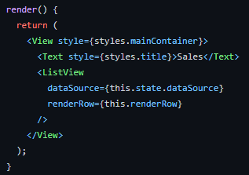
The Render Function

Slide 9
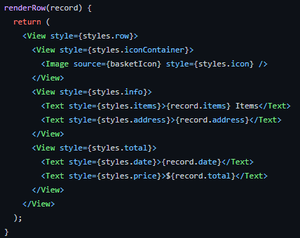
The RenderRow Function

Slide 10
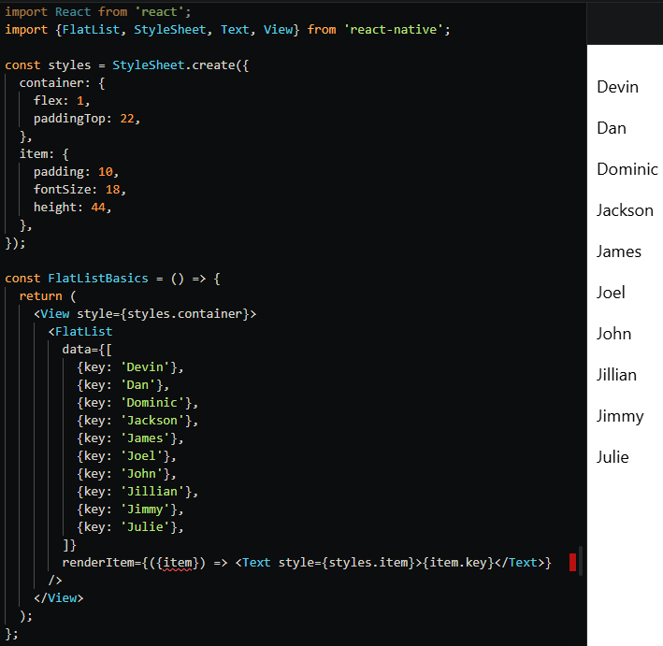
FlatList Example

Slide 11
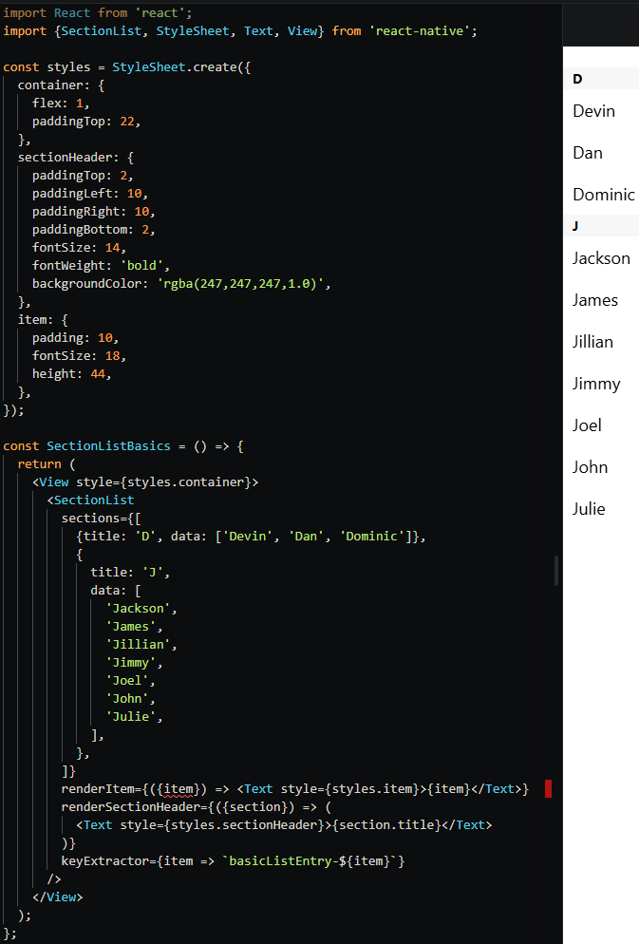
SectionList Example

Slide 12
Wrapping Up Lists
Lists might seem a bit confusing to set up, but they give you a nice way to present data
Be mindful of memory when setting up your list
  ListView is not as efficient as FlatList, but still doesn’t render everything like ScrollView does
The JSON approach for storing data is not required but is probably easier than building some sort of class or map
  cloneWithRows needs a array of data
Be careful if your list involves data retrieved remotely
  We will talk about this in detail in a later module
  For now, know that you will want to use the componentDidMount lifecycle hook to ensure that the UI does not hang waiting for the data

Slide 13
End of List Views
That’s all for Module 3

